Slide 1







Plagiarism Checker
hybrid unsupervised machine learning approach
GROUP 6
Page 1

Slide 2

What problem does this solve?
Academic plagiarism is hard to catch manually at scale
Existing tools (Turnitin) are expensive and opaque black boxes
Our system is open, explainable, and built from scratch
Page 2

Slide 3



System overview
Paste text or upload .txt / .pdf / .docx files
Compare against a corpus OR directly file-to-file
Get an ensemble score + risk level + flagged sentences
Page 3

Slide 4

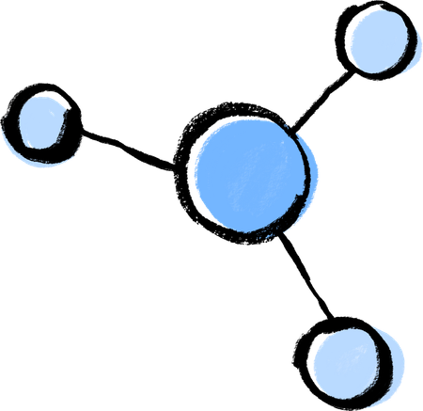
The ML engine: two algorithms, one score
TF-IDF cosine similarity — measures vocabulary overlap (60% weight)
MinHash Jaccard similarity — measures word-sequence overlap (40% weight)
Combined into a single 0–1 ensemble score
Page 4

Slide 5

How well does it work?
Four risk levels
Low
Moderate / High
Critical
Matching
Risks and Issues
Sentence-level highlighting shows exactly what matched
Sentence-level highlighting shows exactly what matched
Page 5

Slide 6
Thank you so much
Discussion Time
Presented by: GROUP 6
Page 6

